Slide 1


Application Security
17-03-2022

Slide 2

Agenda
Web Application Security
Web API Security
Web Service Security

Slide 3
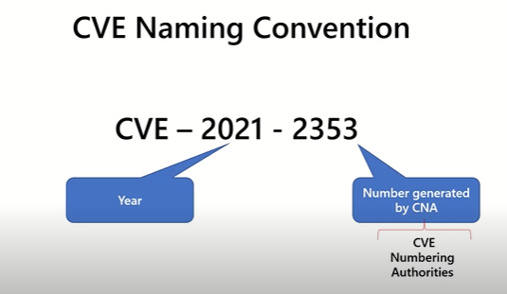
CVE , CWE, CVSS
CVE -
https://cve.mitre.org/
CVSS –
https://www.first.org/cvss/
CWE - https://cwe.mitre.org/
Common vulnerabilities and exposures
list of known instances of vulnerability for specific products or systems defined by MITRE
Common Weakness Enumeration
Community developed list of weakness for software and hardware developed by Mitre
categorizes types of software vulnerabilities
baseline for weakness identification, mitigation, and prevention efforts.
Latest CWE List
Common Vulnerability Scoring System
Released by First.Org

Slide 4
What is WebAppSec?
Securing Web applications
Securing Web API
Securing Web Services

Slide 5
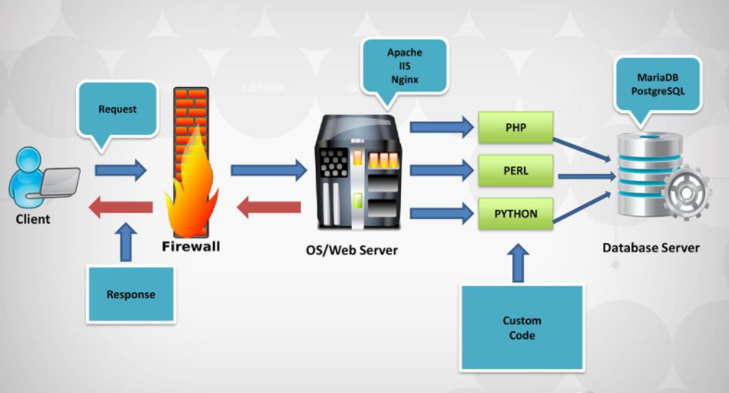
Generic Web Application Set Up

Slide 6
OWASP Web Application Security Risks / Vulnerabilities
Broken Access Control
Cryptographic Failures
Injection
Insecure Design
Security Misconfiguration
Vulnerable and Outdated Components
Identification and Authentication Failures
Software and Data Integrity Failures
Securing Logging and Monitoring Failures
Server-Side Request Forgery

Slide 7
Broken Access Control
Vulnerabilities
Prevention
Linked CWE
Violation of the principle of least privilege
Bypassing access control checks by modifying the URL
Permitting viewing or editing someone else's account
Elevation of privilege
Metadata manipulation
Force browsing to authenticated pages
Except for public resources, deny by default
minimizing Cross-Origin Resource Sharing (CORS) usage
Disable web server directory listing
Log access control failures, alert admins when appropriate
JWT tokens should be invalidated on the server after logout.
CWE-200
CWE-35
CWE-284

Slide 8
Cryptographic Failures
Vulnerabilities
Prevention
Data transmitted in clear text
Use of old or weak cryptographic algorithms or protocols
Default crypto keys in use
Weak crypto keys generated or re-used
Invalid server certificate
passwords being used as cryptographic keys in absence of a password base key derivation function
Use of deprecated hash functions such as MD5 or SHA1
Use of deprecated cryptographic padding methods such as PKCS number 1 v1.5
Discard sensitive data as soon as possible
use PCI DSS compliant tokenization or truncation.
Make sure to encrypt all sensitive data at rest.
Ensure up-to-date and strong standard algorithms, protocols, and keys are in place
Encrypt all data in transit with secure protocols such as TLS
Disable caching for response that contain sensitive data.
Do not use legacy protocols such as FTP and SMTP for transporting sensitive data.
Linked CWE
CWE-259
CWE-327
CWE-331

Slide 9
Injection
Cause
Prevention
Vulnerabilities
User-supplied data is not validated, filtered, or sanitized by the application
Dynamic queries or non-parameterized calls without context-aware escaping are used directly in the interpreter.
Hostile data is used within object-relational mapping (ORM) search parameters to extract additional, sensitive records.
Hostile data is directly used or concatenated
Use positive server-side input validation.
For any residual dynamic queries, escape special characters using the specific escape syntax for that interpreter.
Use LIMIT and other SQL controls within queries to prevent mass disclosure of records in case of SQL injection.
Include static (SAST), dynamic (DAST), and interactive (IAST) application security testing tools into the CI/CD pipeline to identify introduced injection flaws before production deployment.
SQL Injection
No-SQL Injection
OGNL Injection
Linked CWE
CWE-20
CWE-89

Slide 10
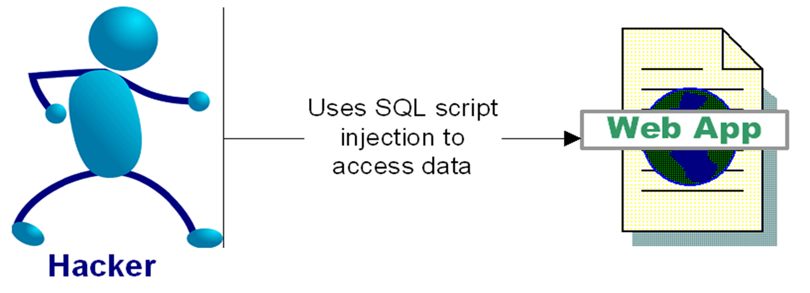
SQL Injection
“SQL injection is a security vulnerability that occurs in the database layer of an application. Its source is the incorrect escaping of dynamically-generated string literals embedded in SQL statements. “
Injection of either a partial or complete SQL query via the data input or transmitted from the client (browser) to the web application

Slide 11
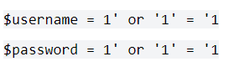
SQL Injection
Query –
Input values-
Final Query-
Result -
This returns a value or set of values as condition is always true and hence authentication is successful without knowing username and password.
Reference –
https://owasp.org/www-project-web-security-testing-guide/latest/4-Web_Application_Security_Testing/07-Input_Validation_Testing/05-Testing_for_SQL_Injection

Slide 12
Insecure Design Focuses on risks related to design and architectural flaws
Cause
Prevention
Linked CWE
The software generates an error message that includes sensitive information about its environment, users, or associated data.
Storing a password in plaintext may result in the compromising of the entire system
Trust Boundary Violation
Insufficiently Protected Credentials
Establish and use a secure development lifecycle
Establish and use a library of secure design patterns
Use threat modeling for critical authentication, access control, business logic, and key flows
Integrate security language
Write unit and integration tests to validate that all critical flows are resistant to the threat model
Segregate tenants robustly by design throughout all tiers
CWE-209
CWE-256
CWE-501
CWE-522

Slide 13
Security Misconfiguration
Cause
Vulnerabilities
Prevention
Missing appropriate security hardening
Unnecessary features are enabled or installed
Default accounts and their passwords are still enabled and unchanged.
Error handling reveals stack traces or other overly informative error messages to users.
For upgraded systems, the latest security features are disabled or not configured securely
The security settings in the application servers, application frameworks are not set to secure values
The software is out of date or vulnerable
The software stores a password in a configuration file that might be accessible to actors who do not know the password.
Debugging messages help attackers learn about the system and plan a form of attack.
The application stores sensitive information in cleartext in a cookie.
an attacker can leverage the conditions that cause unhandled exception errors in order to gain unauthorized access to the system.
A minimal platform without any unnecessary features, components, documentation, and samples
A task to review and update the configurations appropriate to all security notes, updates, and patches as part of the patch management process
A segmented application architecture provides effective and secure separation between components or tenants, with segmentation, containerization, or cloud security groups

Slide 14
Vulnerable and Outdated Components
Cause
Prevention
Linked CWE
If versions of all components as well as nested dependencies are unknown
Software is vulnerable, unsupported, or out of date
Irregular scan of vulnerabilities
Upgrades not done on time.
Insecure components’ configurations
Incompatibility of updated, upgraded, or patched libraries
Remove unused dependencies, unnecessary features, components, files, and documentation.
Obtain components from official sources over secure links
CWE-937
CWE-1035
CWE-1104

Slide 15
Identification and Authentication Failures
Cause
Prevention
Linked CWE
Permits automated attacks such as credential stuffing
Permits brute force attack
Uses weak or ineffective credential recovery and forgot-password processes
Uses plain text, encrypted, or weakly hashed passwords data stores
Exposes session identifier in the URL
Reuse session identifier after successful login
Does not correctly invalidate Session IDs
Implement multi-factor authentication
Do not deploy with any default credentials
Implement weak password checks
Align password length, complexity, and rotation policies with National Institute of Standards and Technology (NIST)
Log all failures and alert administrators when credential stuffing, brute force, or other attacks are detected.
CWE-255
CWE-259
CWE-287
CWE-288

Slide 16
Software and Data Integrity Failures
Cause
Prevention
Linked CWE
An insecure CI/CD pipeline
Auto-update functionality
Data are encoded or serialized into a structure that an attacker can see and modify
Use digital signatures to verify the software or data is from the expected source and has not been altered
Ensure libraries and dependencies are consuming trusted repositories.
Secure CI/CD Process
CWE-494
CWE-829
CWE-502

Slide 17
Security Logging and Monitoring Failures
Cause
Prevention
Linked CWE
Failed logins, and high-value transactions, are not logged.
Warnings and errors generate no, inadequate, or unclear log messages
Logs of applications are not monitored for suspicious activity
Logs are only stored locally.
Penetration testing and scans by dynamic application security testing (DAST) tools do not trigger alerts
Ensure that logs are generated in a format that log management solutions can easily consume.
Ensure log data is encoded correctly to prevent injections or attacks on the logging or monitoring systems.
Ensure high-value transactions have an audit trail
DevSecOps teams should establish effective monitoring and alerting
Establish or adopt an incident response and recovery plan,
CWE-117
CWE-223
CWE-778

Slide 18
Server-Side Request Forgery
Cause
Prevention
Linked CWE
A web application is fetching a remote resource without validating the user-supplied URL
Attacker sends a crafted request to an unexpected destination
Segment remote resource access functionality in separate networks to reduce the impact of SSRF
Do not send raw responses to clients
Don't deploy other security relevant services on front systems
CWE-918

Slide 19
Web API
Web Application
Internet
Web API
Web Server
Database

Slide 20
OWASP Web API Security Risks / Vulnerabilties
Broken Object Level Authorization
Broken User Authentication, Credential Stuffing
Excessive Data Exposure
Lack of Resources and Rate Limiting
Broken Function level authorization
Mass Assignment
Security Misconfiguration
Injection
Improper Asset Management
Insufficient Logging and Monitoring

Slide 21
API1. Broken Object Level Authorization
Definition
Failure
Prevention
It is an access control mechanism that validates that one user can only access objects that they should have access to.
Leads to unauthorized information disclosure, modification, or destruction of all data.
Authorization mechanism that relies on the user policies and hierarchy.
Check if the logged-in user has access to perform the requested action.
Use random and unpredictable values as GUIDs for records’ IDs.

Slide 22
API2. Broken User Authentication, Credential Stuffing
Definition
Causes
Prevention
Gain control to other users’ accounts in the system, read their personal data, and perform sensitive actions
Credential Stuffing
Brute force attack
Weak passwords
Send sensitive authentication details in Url
Does not validity the authenticity of tokens
Use plain text, non-encrypted, weakly hashed passwords
Weak encryption keys
Aware of all the possible flows to authenticate to the API
Use OWASP Authentication Cheat Sheet
Implement multi-factor authentication
Implement anti brute force mechanism

Slide 23
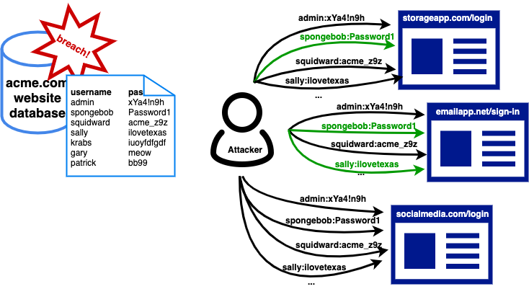
Web API Credential Stuffing
It is automated injection of stolen username and password pairs into website login forms, in order to fraudulently gain access to user accounts.

Slide 24
Credential Stuffing Prevention Cheat Sheet
Multi-Factor Authentication
Secondary Passwords, PINs and Security Questions
CAPTCHA
IP Block-listing
Device Fingerprinting
Require Unpredictable Usernames

Slide 25
API3:2019 Excessive Data Exposure
Definition
Vulnerabilities
Prevention
Performed by sniffing the traffic to analyze the API responses, looking for sensitive data exposure
This data is usually filtered on the client side before being presented to the user.
Never rely on the client side to filter sensitive data
Review the responses from the API
Classify sensitive and personally identifiable information (PII) that your application stores
Implement a schema-based response validation mechanism as an extra layer of security.

Slide 26
Web API Security Tool
Burp suite
Postman, GraphSQL

Slide 27
Web Service Security
Transport Confidentiality
All communication with and between web services containing sensitive features, an authenticated session, or transfer of sensitive data must be encrypted using well-configured with TLS
Server Authentication
TLS must be used to authenticate the service provider to the service consumer.
User Authentication
Basic Authentication must be conducted over TLS
Transport Encoding
Enforce the same encoding style between the client and the server.
Message Integrity
For XML data, use XML digital signatures to provide message integrity using the sender's private key. This signature can be validated by the recipient using the sender's digital certificate (public key).
Message Confidentiality
Messages containing sensitive data must be encrypted using a strong encryption cipher
Authorization
Ensure access to administration and management functions within the Web Service Application is limited to web service administrators.

Slide 28
Web Service Security
Schema Validation
Web services must validate SOAP payloads against their associated XML schema definition (XSD).
Content Validation
web services need to validate input before consuming it
Output Encoding
Ensure that the output sent to clients is encoded to be consumed as data and not as scripts.
Virus Protection
Ensure Virus Scanning technology is regularly updated with the latest virus definitions/rules.
Message Size
SOAP Messages size should be limited to an appropriate size limit. Larger size limit (or no limit at all) increases the chances of a successful DoS attack
Resource Limiting
Limit the amount of memory the web service can use to avoid system running out of memory. In some cases, the host system may start killing processes to free up memory.
Endpoint Security Profile
Web services must be compliant with Web Services-Interoperability (WS-I) Basic Profile at minimum.

Slide 29
OWASP Security Testing Guide Checklist
https://github.com/OWASP/wstg

Slide 30
Few more links…
CORS - https://www.tenable.com/blog/understanding-cross-origin-resource-sharing-vulnerabilities
PCI DSS - https://www.pcisecuritystandards.org/documents/PCI_DSS-QRG-v3_2_1.pdf
PKCS - https://en.wikipedia.org/wiki/PKCS
OWASP SAMM - https://owaspsamm.org/

Slide 31

Thank You!
Jolly.trivedi@ltts.com

